Slide 1


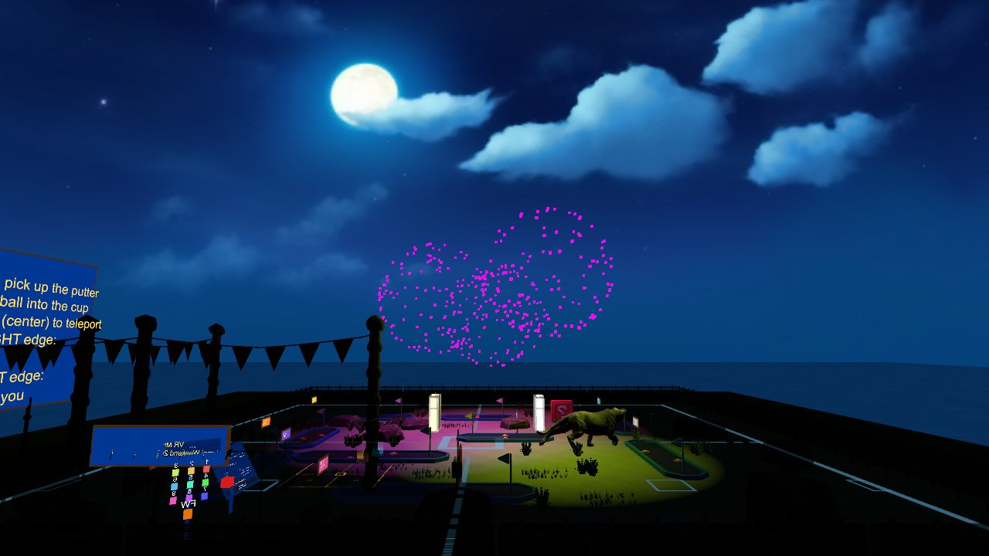

Virtual Reality
Sound and visual effects: spatial audio, a VR drum kit, particles, fog
Wednesdays at 6:00pm
CIST 1423 - 2010 VIRTUAL REALITY PROGRAMMING AND TECHNOLOGY
Exam 3 this week: Ch. 5–7

Slide 2



Agenda
Sound in VR
A VR drum scene
Particles & fog
Theory, AudioSource, spatial audio
Hit speed → loudness
GolfVR's fireworks, fog on collision

Slide 3

Today
By the end of class you can…
Explain frequency, amplitude, HRTF and attenuation in VR
Tonight's plan
1
0–10
Review
Use AudioSource with spatial blend, and scale volume with impact speed
2
10–40
Sound, particles, fog
40–80
Exam 3 (Ch. 5–7)
Build particle effects and runtime fog from code
3
80–140
Lab: audio + particles in your project
140–150
Share-out + exit
CIST 1423 — Week 11 — Adding Sound and Visual Effects (Ch. 7)

Slide 4




Sound theory you need for VR
In a headset, sound tells you where things are before you look.
Frequency & amplitude
Spatial audio (HRTF)
Attenuation
Unity pieces
Pitch (Hz) and loudness (dB)
Low sounds are hard to locate; high sounds are easy
Your head and ears filter sound by direction
Spatialisers simulate this in headphones
Volume falls with distance
Rolloff curve: logarithmic feels natural
AudioListener on the camera (only one!)
AudioSource + AudioClip on objects
Spatial Blend 1 = fully 3D
CIST 1423 — Week 11 — Adding Sound and Visual Effects (Ch. 7)

Slide 5


VR drum: louder when you hit harder
Collision speed drives volume. Same idea as GolfVR's putter strike sound.
[RequireComponent(typeof(AudioSource))]
public class Drum : MonoBehaviour
{
public float maxSpeed = 3f; // m/s for a full-volume hit
AudioSource source;
void Awake()
{
source = GetComponent<AudioSource>();
source.spatialBlend = 1f; // fully 3D
source.playOnAwake = false;
}
void OnCollisionEnter(Collision c)
{
float speed = c.relativeVelocity.magnitude;
if (speed < 0.2f) return; // resting contact
source.pitch = Random.Range(0.96f, 1.04f); // vary it
source.PlayOneShot(source.clip, Mathf.Clamp01(speed / maxSpeed));
}
}
In GolfVR
GolfPutter: PlayOneShot volume from strike power, random pitch
Sounds are generated in code with AudioClip.Create (no audio files)
Add haptics
hand.TriggerHapticPulse(...) on the same hit
Sound + buzz together feels solid
CIST 1423 — Week 11 — Adding Sound and Visual Effects (Ch. 7)

Slide 6



Particles: GolfVR's fireworks, built in code
The burst
AddComponent<ParticleSystem>()
Emission: one burst of 120 particles
Shape: Sphere, random colour
The flash
A Light on the burst, faded out over a second
Plus RenderSettings.skybox / ambientIntensity for night
Read it
FireworksCelebrationController.cs (and GolfHole's confetti)
Every sunk putt: the sky fades to night, firework bursts go off with light flashes and horns, then day returns.
CIST 1423 — Week 11 — Adding Sound and Visual Effects (Ch. 7)

Slide 7


Fog on collision
The Ch. 7 exercise: touching an object rolls fog in, and it clears again.
public class FogOnCollision : MonoBehaviour
{
public Color fogColor = new Color(0.6f, 0.65f, 0.7f);
public float targetDensity = 0.08f, seconds = 2f;
void OnCollisionEnter(Collision c) => StartCoroutine(RollIn());
IEnumerator RollIn()
{
RenderSettings.fog = true;
RenderSettings.fogMode = FogMode.ExponentialSquared;
RenderSettings.fogColor = fogColor;
for (float t = 0; t < 1; t += Time.deltaTime / seconds)
{
RenderSettings.fogDensity = Mathf.Lerp(0, targetDensity, t);
yield return null;
}
}
}
Fog in VR
Great for mood and hiding far scenery
Too dense = claustrophobic; test in the headset
Exam 3: Ch. 5–7
No-code vs C# interactivity
AR menus: raycast, place, swap
Audio, particles, fog
CIST 1423 — Week 11 — Adding Sound and Visual Effects (Ch. 7)

Slide 8
Check your understanding
Answer with a partner first, then we'll compare.
Q1
Q2
Spatial Blend = 0 vs 1?
How many AudioListeners per scene?
Q3
Q4
Why randomise pitch slightly on repeated hits?
Where does the Playground's target get its sparks?
CIST 1423 — Week 11 — Adding Sound and Visual Effects (Ch. 7)
Notes:
Answers:
Q1. Spatial Blend = 0 vs 1?
0 = 2D (same everywhere); 1 = fully 3D, positioned in space.
Q2. How many AudioListeners per scene?
One, usually on the camera.
Q3. Why randomise pitch slightly on repeated hits?
Identical repeats sound artificial.
Q4. Where does the Playground's target get its sparks?
A ParticleSystem burst of 40 particles created by ThrowTarget / the builder.

Slide 9

Next steps: homework + planning
Add an AudioSource and a particle effect to your project; push code + README.md
Stretch: make the effect react to how hard something was hit
Exam 3 covers Ch. 5–7
Next week: Ch. 8, hand tracking, gaze, and multiplayer
CIST 1423 — Week 11 — Adding Sound and Visual Effects (Ch. 7)

